Slide 1

2.2 Mergesort
Algorithms
Robert Sedgewick | Kevin Wayne
http://algs4.cs.princeton.edu
Modified by Mutlu Mete

Slide 2













Two classic sorting algorithms: mergesort and quicksort
Critical components in the world’s computational infrastructure.
Full scientific understanding of their properties has enabled us to develop them into practical system sorts.
Quicksort honored as one of top 10 algorithms of 20th century in science and engineering.
Mergesort. Quicksort.
...
...
Notes:
These two algorithms are among the most important in all of computer science. Not only because they are solve an important and are widely used, but because they demonstrate general techniques.
Mergesort. [this lecture]
Java sort for objects.
Perl, C++ stable sort, Python stable sort, Firefox, JavaScript, GNU Octave, Android, ...
Quicksort. [next lecture]
Java sort for primitive types.
C, Unix, Visual C++, Python, Matlab, Chrome, JavaScript, …
g++ uses introsort (quicksort with switchover to heapsort for pathological inputs)

Slide 3
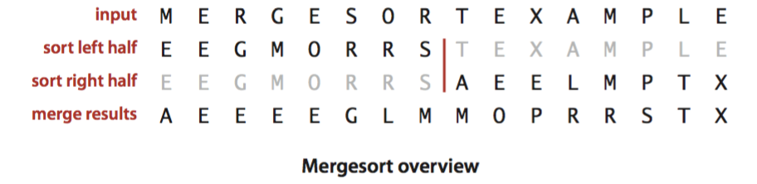
Mergesort
Basic plan.
Divide array into two halves.
Recursively sort each half.
Merge two halves.
Notes:
Jon von Neumann (left), ENIAC (right).
Earliest extant program for a stored program computer (according to Knuth), though not the earliest computer program (Lady Lovelace computer Bernoulli numbers; Eckert and Mauchly had sample programs for the ENIAC).
Von Nuemann knew that the computer he designed would be good at numerical applications (since that was how the machine was designed). A key question was whether his machine would be good at nonnumerical applications. He chose sorting because IBM had special-purpose sorting machines against which he could compare his solution.
Knuth notes a few errors and clumsy coding :)

Slide 4
Abstract in-place merge demo
Goal. Given two sorted subarrays a[lo] to a[mid] and a[mid+1] to a[hi], replace with sorted subarray a[lo] to a[hi].
lo
mid
mid+1
hi
a[]
E | E | G | M | R | A | C | E | R | T
sorted
sorted
Notes:
Run 22DemoMerge.key

Slide 5
Abstract in-place merge demo
Goal. Given two sorted subarrays a[lo] to a[mid] and a[mid+1] to a[hi], replace with sorted subarray a[lo] to a[hi].
lo
hi
a[]
A | C | E | E | E | G | M | R | R | T
sorted

Slide 6
Merging: implementation
void merge(int a[], int aux[], int lo, int mid, int hi) {
for (int k = lo; k <= hi; k++) aux[k] = a[k];
int i = lo, j = mid+1; for (int k = lo; k <= hi; k++) {
if (i > mid) a[k] = aux[j++]; else if (j > hi) a[k] = aux[i++]; else if (less(aux[j], aux[i])) a[k] = aux[j++]; else a[k] = aux[i++];
}
}
copy
merge
lo
i
mid
j
hi
aux[]
A
G
L
O
R
H
I
M
S
T
k
a[]
A
G
H
I
L
M
Notes:
Q. How many compares (i.e. calls to less) are made in the worst case when merging two subarrays of length N/2 into a single array of length N?
A. N-1
A. N/2 [149918] D. N [878502]
B. N/2 + 1 [149927] E. N+1 [777444]
C. N-1 [149941]

Slide 7
Mergesort: C++ implementation
void merge(...)
{ /* as before */ }
void sort(int a[], int aux[], int lo, int hi)
{
if (hi <= lo) return;
int mid = lo + (hi - lo) / 2;
sort(a, aux, lo, mid);
sort(a, aux, mid+1, hi);
merge(a, aux, lo, mid, hi);
}
void sort(int a[])
{
int *aux = new int[N];
sort(a, aux, 0, N- 1);
}
lo
mid
hi
10
11
12
13
14
15
16
17
18
19
Notes:
It's important not to create the auxiliary array in the recursive routine. Otherwise you allocate memory for lots of arrays unnecessarily.
Subtle bug: why not mid = (lo + hi) / 2 ? Breaks if lo + hi overflows an int. This bug was hidden in many implementations for years, including Java system sort.

Slide 8
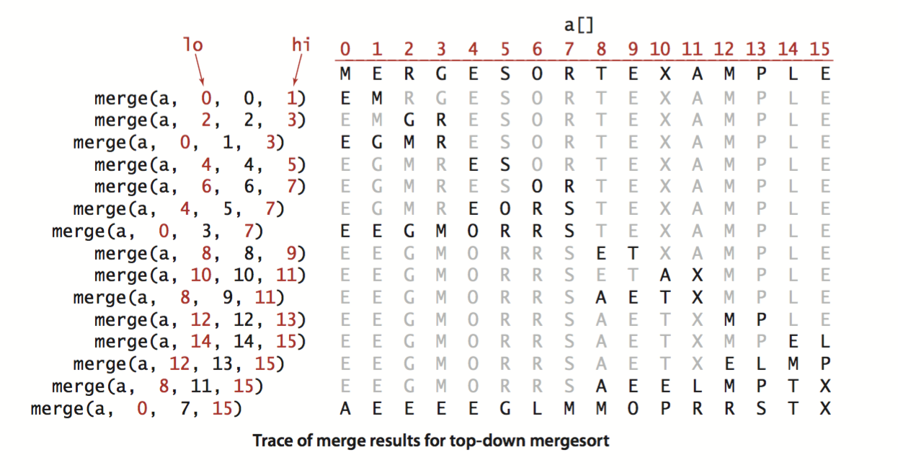
Mergesort: trace
result after recursive call

Slide 9

Mergesort: animation
50 random items
algorithm position
in order
current subarray
not in order
http://www.sorting-algorithms.com/merge-sort

Slide 10

Mergesort: animation
50 reverse-sorted items
algorithm position
in order
current subarray
not in order
http://www.sorting-algorithms.com/merge-sort

Slide 11
Mergesort: empirical analysis
Running time estimates:
Laptop executes 10⁸ compares/second.
Supercomputer executes 10¹² compares/second.
Bottom line. Good algorithms are better than supercomputers.
 | insertion sort (N²) |  |  | mergesort (N log N)
computer | thousand | million | billion | thousand | million | billion
home | instant | 2.8 hours | 317 years | instant | 1 second | 18 min
super | instant | 1 second | 1 week | instant | instant | instant
Notes:
Let's try to understand why

Slide 12
Mergesort: number of compares
Proposition. Mergesort uses ≤ N lg N compares to sort an array of length N.
Pf sketch. The number of compares C (N) to mergesort an array of length N satisfies the recurrence:
C (N) <= C ([N / 2]) + C ([N / 2]) + N for N > 1, with C (1) = 0.
We solve the recurrence when N is a power of 2:
D (N) = 2 D (N / 2) + N, for N > 1, with D (1) = 0.
left half
right half
merge
result holds for all N
(analysis cleaner in this case)
Notes:
Note, it's <= because the merge step might take many fewer than N compares (6N array accesses) if one half is exhausted long before the other
similar recurrences hold for many divide-and-conquer algorithms

Slide 13
Divide-and-conquer recurrence: proof by picture
Proposition. If D (N) satisfies D (N) = 2 D (N / 2) + N for N > 1, with D (1) = 0,
then D (N) = N lg N.
Pf 1. [assuming N is a power of 2]
D (N)
N
= N
D (N / 2)
D (N / 2)
2 (N/2)
= N
lg N
D(N / 4)
D(N / 4)
D(N / 4)
D(N / 4)
4 (N/4)
= N
D(N / 8)
D(N / 8)
D(N / 8)
D(N / 8)
D(N / 8)
D(N / 8)
D(N / 8)
D(N / 8)
8 (N/8)
= N
⋮
⋮
T(N) = N lg N

Slide 14
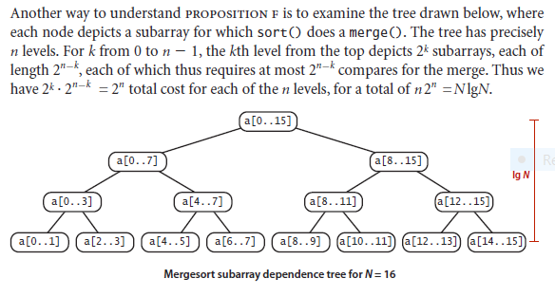
k=0
n=4
k=3, len 2⁴⁻³ =2
2⁴⁻³ = 2= compares
1, 3 and 2, 7 => N-1 compares ~ N compares
1vs2, 3vs2, 3vs7

Slide 15
Mergesort: number of array accesses
Proposition. Mergesort uses ≤ 6 N lg N array accesses to sort an array of length N.
Pf sketch. The number of array accesses A (N) satisfies the recurrence:
A (N) ≤ A (⎡N / 2⎤) + A (⎣N / 2⎦) + 6 N for N > 1, with A (1) = 0.
Key point. Any algorithm with the following structure takes N log N time:
Notable examples. FFT, hidden-line removal, Kendall-tau distance, …
public static void linearithmic(int N)
{
if (N == 0) return;
linearithmic(N/2);
linearithmic(N/2);
linear(N);
}
solve two problems
of half the size
do a linear amount of work
Notes:
no need to resolve from scratch each time

Slide 16
Mergesort analysis: memory
Proposition. Mergesort uses extra space proportional to N.
Pf. The array aux[] needs to be of length N for the last merge.
Def. A sorting algorithm is in-place if it uses ≤ c log N extra memory.
Ex. Insertion sort, selection sort, shellsort.
Challenge 1 (not hard). Use aux[] array of length ~ ½ N instead of N.
Challenge 2 (very hard). In-place merge. [Kronrod 1969]
two sorted subarrays
A C D G H I M N U V
B E F J O P Q R S T
A B C D E F G H I J M N O P Q R S T U V
merged result
Notes:
Note: not hard to use extra space proportional to N/2 (only copy left subarray to auxiliary array, entries in right subarray will not get in the way)
cannot fill the memory and sort
Kronrod, M. A. (1969). "Optimal ordering algorithm without operational field". Soviet Mathematics - Doklady 10: pp. 744
Note: an in-place N log N merge (and N log^2 N mergesort) is practical and used in the C++ STL when the user needs to stably sort with limited memory.

Slide 17
Mergesort: practical improvements
Use insertion sort for small subarrays.
Mergesort has too much overhead for tiny subarrays.
Cutoff to insertion sort for ≈ 10 items. It is 7 in java.
void sort(int a[], int aux[], int lo, int mid, int hi)
{
if (hi <= lo + CUTOFF - 1) {
Insertion.sort(a, lo, hi);
return;
}
int mid = lo + (hi - lo) / 2;
sort (a, aux, lo, mid);
sort (a, aux, mid+1, hi);
merge(a, aux, lo, mid, hi);
}
Notes:
7 = cutoff value to insertion sort in Arrays.sort()
One line of code will make it maybe 20% faster.

Slide 18
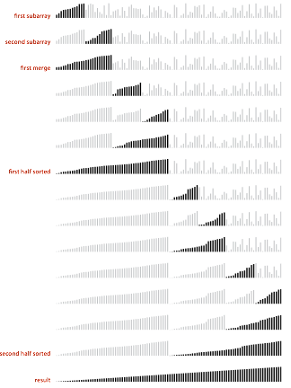
Mergesort with cutoff to insertion sort: visualization
Notes:
cutoff for small subarrays

Slide 19
Mergesort: practical improvements
Stop if already sorted.
Is largest item in first half ≤ smallest item in second half?
Helps for partially-ordered arrays.
A B C D E F G H I J
M N O P Q R S T U V
A B C D E F G H I J M N O P Q R S T U V
private static void sort(Comparable[] a, Comparable[] aux, int lo, int hi)
{
if (hi <= lo) return;
int mid = lo + (hi - lo) / 2;
sort (a, aux, lo, mid);
sort (a, aux, mid+1, hi);
if (!less(a[mid+1], a[mid])) return;
merge(a, aux, lo, mid, hi);
}
Notes:
improves mergesort if array is partially sorted.
Linear number of compares if already sorted.
one line of code gets the job done

Slide 20
Mergesort: practical improvements
Eliminate the copy to the auxiliary array. Save time (but not space) by switching the role of the input and auxiliary array in each recursive call.
private static void merge(int a[], int aux[], int lo, int mid, int hi) {
int i = lo, j = mid+1; for (int k = lo; k <= hi; k++) {
if (i > mid) aux[k] = a[j++];
else if (j > hi) aux[k] = a[i++]; else if (less(a[j], a[i])) aux[k] = a[j++]; else aux[k] = a[i++];
}
}
private static void sort(int a[], int aux[], int lo, int mid, int hi)
{
if (hi <= lo) return;
int mid = lo + (hi - lo) / 2;
sort (aux, a, lo, mid);
sort (aux, a, mid+1, hi);
merge(a, aux, lo, mid, hi);
}
merge from a[] to aux[]
assumes aux[] is initialize to a[] once,
before recursive calls
switch roles of aux[] and a[]
Notes:
a little mind-bending, so we recommend it only for experts.
Also, need to modify the nonrecursive sort() to copy a[] into aux[] before calling.

Slide 21

Java 6 system sort
Basic algorithm for sorting objects = mergesort.
Cutoff to insertion sort = 7.
Stop-if-already-sorted test.
Eliminate-the-copy-to-the-auxiliary-array trick.
Arrays.sort(a)
http://www.java2s.com/Open-Source/Java/6.0-JDK-Modules/j2me/java/util/Arrays.java.html

Slide 22


2.2 Mergesort
mergesort
bottom-up mergesort
sorting complexity
comparators
stability
http://algs4.cs.princeton.edu

Slide 23
2.2 Mergesort
mergesort
bottom-up mergesort
sorting complexity
comparators
stability
http://algs4.cs.princeton.edu

Slide 24
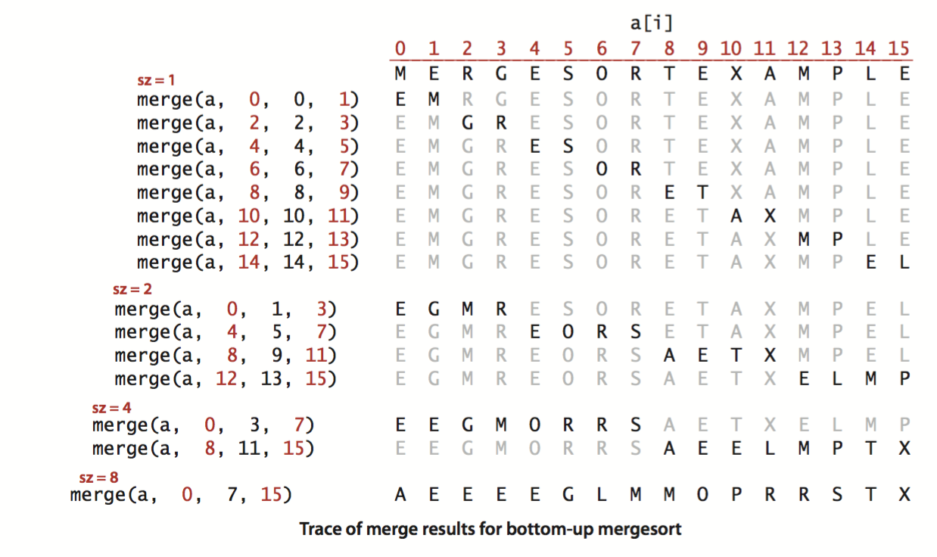
Bottom-up mergesort
Basic plan.
Pass through array, merging subarrays of size 1.
Repeat for subarrays of size 2, 4, 8, ....
Notes:
same set of merges as top-down mergesort when N is a power of 2 (but in a different order)
different set of merges when N is not a power of 2

Slide 25
Bottom-up mergesort: Java implementation
Bottom line. Simple and non-recursive version of mergesort.
void merge(...)
{ /* as before */ }
void sort(int a[])
{
int *aux = new int[N];
for (int sz = 1; sz < N; sz = sz+sz)
for (int lo = 0; lo < N-sz; lo += sz+sz)
merge(a, aux, lo, lo+sz-1, min(lo+sz+sz-1, N-1));
}
but about 10% slower than recursive,
top-down mergesort on typical systems
Notes:
this code might be better suited for an embedded device or assembly language
Conventional wisdom is that recursion is slower than iterative counterpart. But not always true. In this case, the recursive version is faster because of caching.

Slide 26
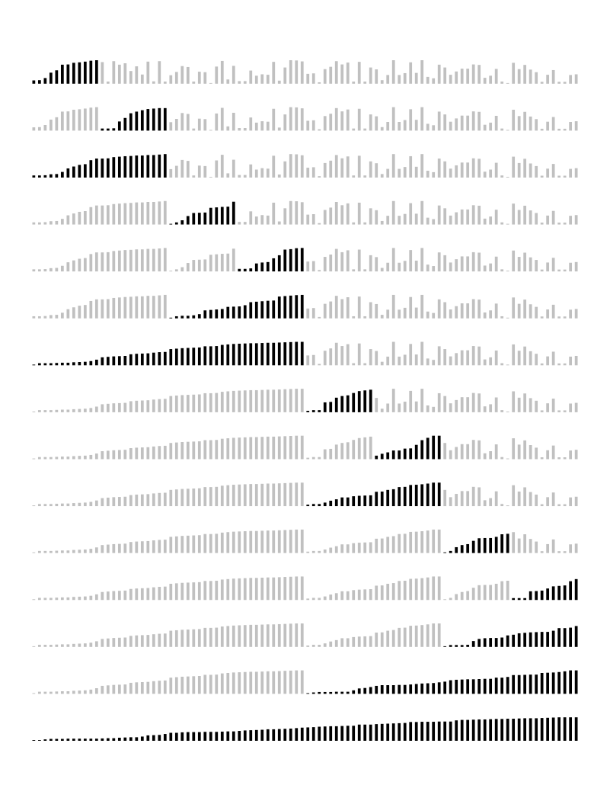
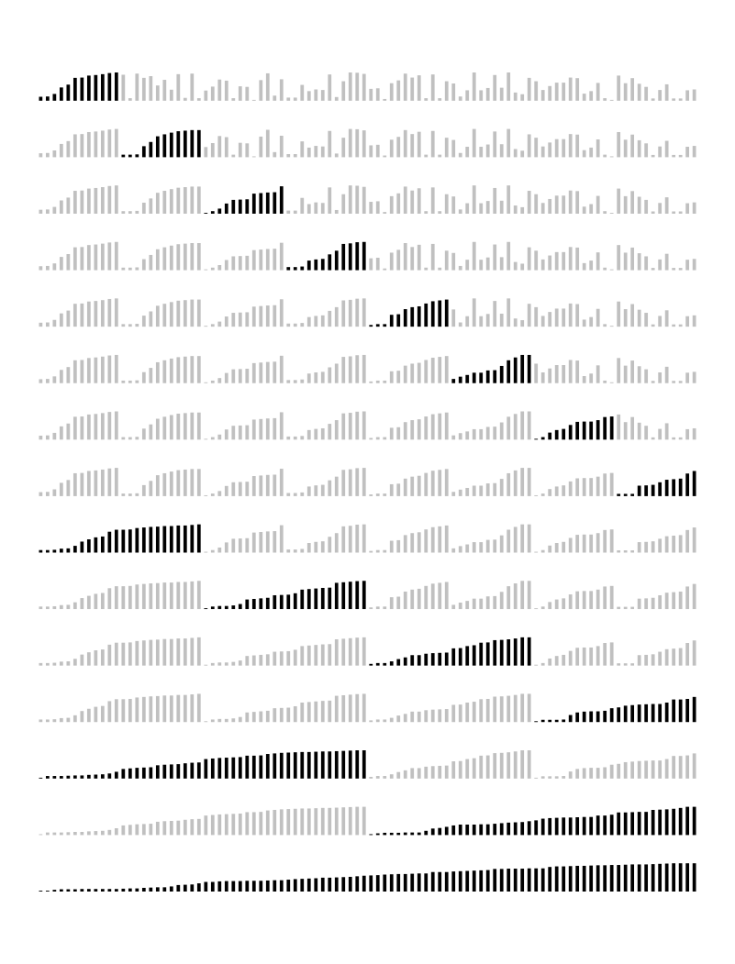
Mergesort: visualizations
top-down mergesort (cutoff = 12)
bottom-up mergesort (cutoff = 12)
Notes:
Here N = 96.
cutoff for small subarrays when N = 12
when N is a power of 2 times the cutoff size, top-down and bottom-up do exactly the same compares and merges but in a different order

Slide 27
Natural mergesort
Idea. Exploit pre-existing order by identifying naturally-occurring runs.
Tradeoff. Fewer passes vs. extra compares per pass to identify runs.
input
1 | 5 | 10 | 16 | 3 | 4 | 23 | 9 | 13 | 2 | 7 | 8 | 12 | 14
first run
1 | 5 | 10 | 16 | 3 | 4 | 23 | 9 | 13 | 2 | 7 | 8 | 12 | 14
second run
1 | 5 | 10 | 16 | 3 | 4 | 23 | 9 | 13 | 2 | 7 | 8 | 12 | 14
merge two runs
1 | 3 | 4 | 5 | 10 | 16 | 23 | 9 | 13 | 2 | 7 | 8 | 12 | 14
Notes:
natural mergesort: look for increasing/decreasing runs (if strictly decreasing, reverse in place - need strictly decreasing for stability)

Slide 28
Stability
A typical application. First, sort by name; then sort by section.
@#%&@! Students in section 3 no longer sorted by name.
A stable sort preserves the relative order of items with equal keys.
Selection.sort(a, new Student.ByName());
Selection.sort(a, new Student.BySection());
Andrews | 3 | A | 664-480-0023 | 097 Little
Battle | 4 | C | 874-088-1212 | 121 Whitman
Chen | 3 | A | 991-878-4944 | 308 Blair
Fox | 3 | A | 884-232-5341 | 11 Dickinson
Furia | 1 | A | 766-093-9873 | 101 Brown
Gazsi | 4 | B | 766-093-9873 | 101 Brown
Kanaga | 3 | B | 898-122-9643 | 22 Brown
Rohde | 2 | A | 232-343-5555 | 343 Forbes
Furia | 1 | A | 766-093-9873 | 101 Brown
Rohde | 2 | A | 232-343-5555 | 343 Forbes
Chen | 3 | A | 991-878-4944 | 308 Blair
Fox | 3 | A | 884-232-5341 | 11 Dickinson
Andrews | 3 | A | 664-480-0023 | 097 Little
Kanaga | 3 | B | 898-122-9643 | 22 Brown
Gazsi | 4 | B | 766-093-9873 | 101 Brown
Battle | 4 | C | 874-088-1212 | 121 Whitman
Notes:
Note: Java system sort is stable so result on right can't happen.

Slide 29
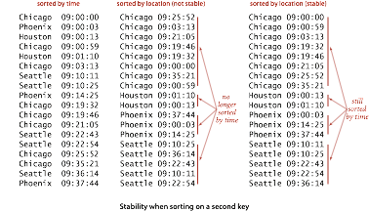
Stability
Q. Which sorts are stable?
A. Need to check algorithm (and implementation).
Notes:
[wayne s14] use this stability example on previous slide?
need to check implementation details (e.g., less than vs. less than or equal to)

Slide 30
Stability: insertion sort
Proposition. Insertion sort is stable.
Pf. Equal items never move past each other.
public class Insertion {
public static void sort(Comparable[] a)
{
int N = a.length;
for (int i = 0; i < N; i++)
for (int j = i; j > 0 && less(a[j], a[j-1]); j--)
exch(a, j, j-1);
}
}
i | j | 0 | 1 | 2 | 3 | 4
0 | 0 | B1 | A1 | A2 | A3 | B2
1 | 0 | A1 | B1 | A2 | A3 | B2
2 | 1 | A1 | A2 | B1 | A3 | B2
3 | 2 | A1 | A2 | A3 | B1 | B2
4 | 4 | A1 | A2 | A3 | B1 | B2
 |  | A1 | A2 | A3 | B1 | B2
Notes:
only adjacent entries are compared and exchanged

Slide 31
Stability: selection sort
Proposition. Selection sort is not stable.
Pf by counterexample. Long-distance exchange can move one equal item past another one.
public class Selection
{
public static void sort(Comparable[] a)
{
int N = a.length;
for (int i = 0; i < N; i++)
{
int min = i; for (int j = i+1; j < N; j++)
if (less(a[j], a[min]))
min = j;
exch(a, i, min);
}
}
}
i | min | 0 | 1 | 2
0 | 2 | B1 | B2 | A
1 | 1 | A | B2 | B1
2 | 2 | A | B2 | B1
 |  | A | B2 | B1

Slide 32
Stability: shellsort
Proposition. Shellsort sort is not stable.
Pf by counterexample. Long-distance exchanges.
public class Shell
{
public static void sort(Comparable[] a)
{
int N = a.length;
int h = 1;
while (h < N/3) h = 3*h + 1;
while (h >= 1)
{
for (int i = h; i < N; i++)
{
for (int j = i; j > h && less(a[j], a[j-h]); j -= h)
exch(a, j, j-h);
}
h = h/3;
}
}
}
h | 0 | 1 | 2 | 3 | 4
 | B1 | B2 | B3 | B4 | A1
4 | A1 | B2 | B3 | B4 | B1
1 | A1 | B2 | B3 | B4 | B1
 | A1 | B2 | B3 | B4 | B1

Slide 33
Stability: mergesort
Proposition. Mergesort is stable.
Pf. Suffices to verify that merge operation is stable.
public class Merge
{
private static void merge(...)
{ /* as before */ }
private static void sort(Comparable[] a, Comparable[] aux, int lo, int hi)
{
if (hi <= lo) return;
int mid = lo + (hi - lo) / 2;
sort(a, aux, lo, mid);
sort(a, aux, mid+1, hi);
merge(a, aux, lo, mid, hi);
}
public static void sort(Comparable[] a)
{ /* as before */ }
}
Notes:
data movement occurs only in merge()

Slide 34
Stability: mergesort
Proposition. Merge operation is stable.
Pf. Takes from left subarray if equal keys.
private static void merge(...) {
for (int k = lo; k <= hi; k++) aux[k] = a[k];
int i = lo, j = mid+1; for (int k = lo; k <= hi; k++) {
if (i > mid) a[k] = aux[j++]; else if (j > hi) a[k] = aux[i++]; else if (less(aux[j], aux[i])) a[k] = aux[j++]; else a[k] = aux[i++];
}
}
0 | 1 | 2 | 3 | 4
A1 | A2 | A3 | B | D
5 | 6 | 7 | 8 | 9 | 10
A4 | A5 | C | E | F | G
Notes:
two equal keys on the same half won't change relative order;
two equal keys on different halves won't change relative order because we take from left subarray if equal

Slide 35
Sorting summary
 | inplace? | stable? | best | average | worst | remarks
selection | ✔ |  | ½ N ² | ½ N ² | ½ N ² | N exchanges
insertion | ✔ | ✔ | N | ¼ N ² | ½ N ² | use for small N or partially ordered
shell | ✔ |  | N log3 N | ? | c N ^{3/2} | tight code; subquadratic
merge |  | ✔ | ½ N lg N | N lg N | N lg N | N log N guarantee; stable
timsort |  | ✔ | N | N lg N | N lg N | improves mergesort when preexisting order
? | ✔ | ✔ | N | N lg N | N lg N | holy sorting grail
Notes:
stable inplace mergesort achieves the holy grail, but is impractical

Slide 36
2.2 Mergesort
mergesort
bottom-up mergesort
sorting complexity
comparators
stability
http://algs4.cs.princeton.edu

Slide 37
2.2 Mergesort
Algorithms
Robert Sedgewick | Kevin Wayne
mergesort
bottom-up mergesort
sorting complexity
comparators
stability
http://algs4.cs.princeton.edu

